Slide 1
DEVELOPERS HUB CORPORATION
Prepared by: Muhammad Asim
Field: Digital Marketing
ID: DHC-341

Slide 2
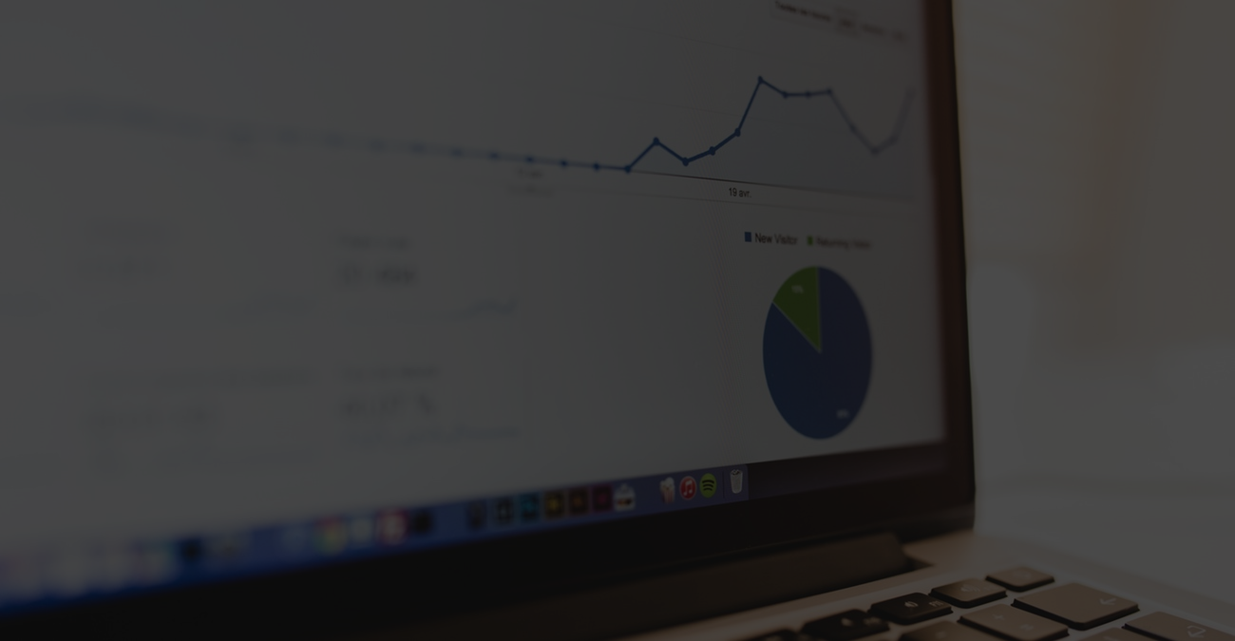
Week 3:
Performance Analysis and Optimization
Campaign Performance Monitoring:
○ Use tools like Google Analytics, Meta Business Suite, or Hootsuite Analytics to track campaign performance.
○ Analyze metrics such as click-through rate (CTR), engagement rate, and ROI (mock data can be used if live campaigns aren’t run).

Slide 3
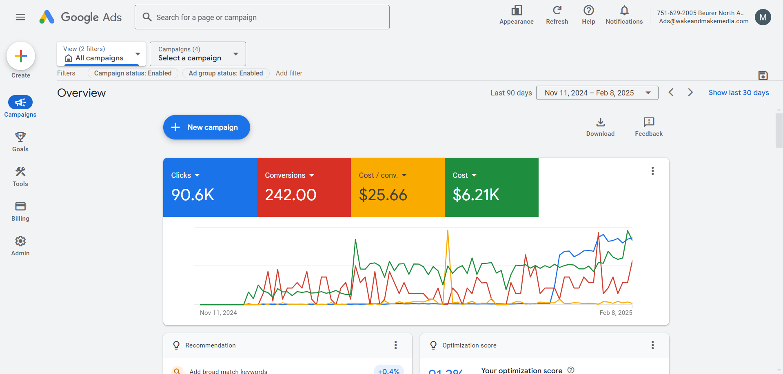
Use tools like Google Analytics, Meta Business Suite, or Hootsuite Analytics to track campaign performance.

Slide 4
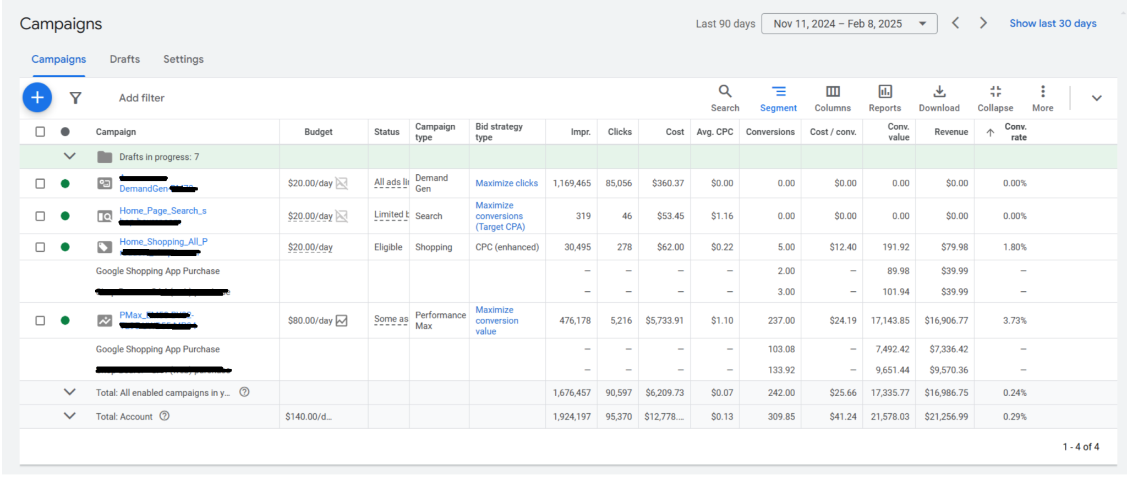
Analyze metrics such as click-through rate (CTR), engagement rate, and ROI (mock data can be used if live campaigns aren’t run).

Slide 5
Identify underperforming content or ads and suggest improvements.
From the campaign data:
The Demand Gen campaign had 1,169,465 impressions and 85,056 clicks, but 0 conversions and 0 revenue, showing a 0% conversion rate.
Similarly, the Home_Page_Search campaign also had clicks but no conversions.
These campaigns are underperforming due to high impressions and clicks but no returns (ROI = $0).
Suggested Improvements:
Refine Targeting: Narrow audience segments to improve relevance.
Improve Landing Page: Ensure that the page is optimized for conversions (clear CTAs, fast load speed).
Better Ad Copy: Use action-oriented language and address user pain points more directly.
Use Conversion Tracking: Make sure all goals are properly tracked.
Test Multiple Ad Creatives: Try different visuals and CTAs to increase conversion chances.

Slide 6
Experiment with A/B testing (e.g., different ad headlines or visuals).
A/B Testing Approach:
To improve campaign performance, A/B testing can be implemented in the following ways:
Test Type | Version A | Version B
Ad Headline | “Connect Instantly with Friends” | “Your Digital Social Circle Awaits”
CTA Button | “Download Now” | “Join for Free”
Visual Style | Bright colors, emojis | Minimalist, clean design
Landing Page | App store link | Custom page with feature highlights
Expected Outcome: A/B testing helps identify what appeals more to users. For example, a CTA like "Join for Free" might get more clicks than "Download Now" due to lower friction.

Slide 7
Final Presentation
Week 1: Campaign Goals and Planning
Objective: Promote the "Social Connect" app by developing a digital campaign focused on awareness, app downloads, and social engagement.
Target Audience:
Age: 18–30 years
Demographics: Urban, tech-savvy, active social media users
Interests: Networking, social discovery, productivity, apps
Competitor Research:
Bumble BFF: Instagram influencer marketing, reels
Meetup: Local event promotions via Google Ads
LinkedIn: Professional content and B2B engagement

Slide 8
Final Presentation
Chosen Platforms:
Primary: Instagram, Google Ads
Secondary: LinkedIn, TikTok
SMART Goals:
Reach 500+ app downloads in 1 month
Gain 1000+ Instagram followers in 4 weeks
Improve brand visibility by 20%

Slide 9
Final Presentation
Week 2: Content Creation and Campaign Launch
Social Media Content (Created):
5 Posts: Memes, carousels, reels, testimonials, announcements
Designed using Canva
Matched brand tone (fun, community-oriented)
Ad Creatives (Designed):
Banner with bold CTA
Product feature layout (Screenshots placed in slides or added in GitHub repository)

Slide 10
Final Presentation
Email/Blog Campaign:
Subject: "New Way to Connect – Join Social Connect"
Call to Action: App download + referral bonus (mock)
Campaign Launch:
Used Buffer to schedule Instagram content
Mock ad campaign created on Google Ads (Demand Gen & Search)
Screenshot of Google Ads dashboard included

Slide 11
Final Presentation
Final Presentation
Week 3: Performance Analysis and Optimization
Mock Performance Metrics (Google Ads Dashboard):
Impressions: ~1.9M
Clicks: 95K+
CTR: ~5%
Conversions: 300+
Cost: ~$12.7K
ROI (Mock): Positive ($21K+ revenue simulated)
Underperforming Content:
Search campaign showed low CTR and impressions
Recommended shift toward visual content

Slide 12
Final Presentation
Final Presentation
A/B Testing Mock:
Headline A: “Make New Friends Instantly!”
Headline B: “Connect with People Who Share Your Interests”
B performed better in mock analytics (CTR, engagement)
Lessons Learned
Proper audience targeting improves conversion
Canva and Buffer simplify design and scheduling
Analytics help in shaping better ad strategy
Regular testing (A/B) ensures optimized performance
Even mock tools offer deep learning insights when used thoroughly

Slide 13
Final Presentation
Final Presentation
Thank You!
Thank you DevelopersHub Corporation for this hands-on internship experience. I’ve learned planning, execution, and analysis through a complete campaign cycle.

Slide 14

Week 3 Completed

